Slide 1
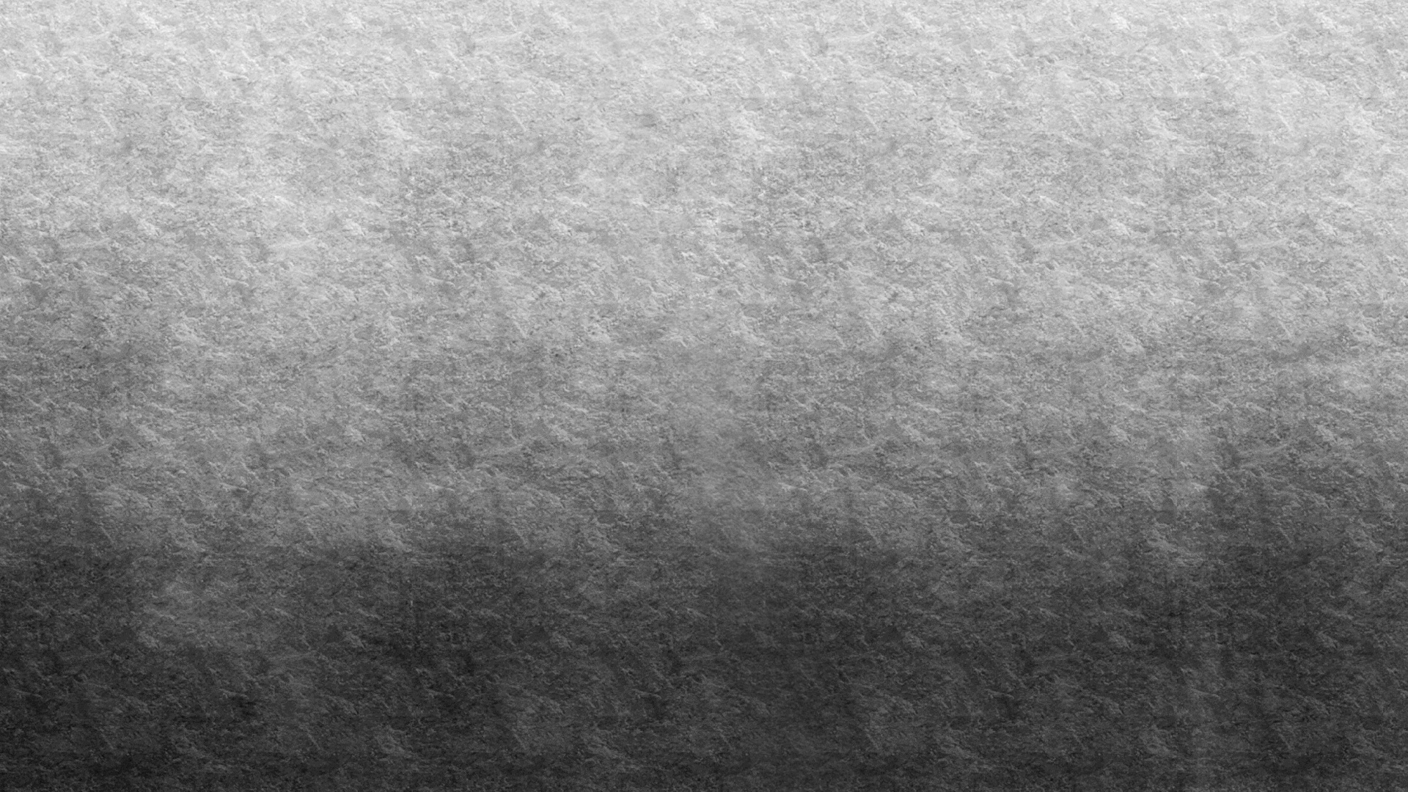

Face Mask Detection using CNN
Selected Topics of Computer Science – 2

Slide 2


Team Details
Name | Id
مصطفي محي الدین مصطفي احمد | 201900834
محمد على محمود محمد | 201900712
باكینام حسام فاروق اسماعیل | 201900217
امنیھ محمد احمد محمد جلال | 201900176
محمد اسامھ محمد سلامة الدرش | 201900630
مازن رييع عبد الحميد رييع | 201900607
شدى اشرف عبد الجواد عبد الحمید | 201900366
محمد احمد رفاعي عبدالحلیم | 201900622

Slide 3

Paper Details

Slide 4
Paper Details
Title: MEDICAL FACE MASK DETECTION USING CNN
Authors: Archana Pushparaj, Raji Rajendran, Sophia BJ, Vishnupriya PB and Al shaina. S
Publisher: JETIR Research Journal
Date: June 2021

Slide 5
Paper Details
The Dataset that has been used in the paper is RMFD and Kaggle which consist of real images or people, the authors wanted to avoid using morphed or fake images.
It consists of 4095 images or two classes (2165 images of with mask and 1930 images of without mask).
The Data is split into three parts which are data processing, testing and evaluation.
Splitting of data is done to avoid overfitting.
The architecture of the implementation using CNN consists of four main steps that are Pre-Processing, Model Creation, Model Training and Model Prediction. To explain each step briefly... In the pre-processing phase, pre-processing was applied to the images to be able to be fed in a neural network.
The images were resized to 224x224 and converted to NumPy arrays. In the Model Creation, the Activation function ReLU was used as well as Max Pooling.
The CNN model includes two convolutional layers, a dropout is added to prevent Neural Networks from Over-fitting as well as fully connected layers at the end.
In Model Training, 90% of the data is used for training and 10% were used for testing them. Finally in the Model Prediction, the models are evaluated by predicting test data labels.
Results Metrics like accuracy precision and recall and selected mobile net v2 architecture were evaluated with the best performance having 100% precision and 99% recall.

Slide 6
Project Description

Slide 7
Project Description
The Dataset used is called “Face Mask Detection Data” on Kaggle, It is a data of 4000 images classified into two classed that are masked and unmasked faces and their labels respectively are "with_mask" and "without_mask".
It can be found here: https://www.kaggle.com/datasets/aneerbanchakraborty/facemask-detection-data

Slide 8
Project Description
In the pre-processing phase, the images were resized to 224x224, 80% were used for training which were about 3200 images, and 20% were used for testing which were about 800.
Hyperparameters used in the implementation include:
1. INIT_LR which represents Learning rate
2.EPOCHS which represent No. of Epochs
3. BS which represents the Batch Size
Check the Block Diagram in the Following page to show main steps

Slide 9
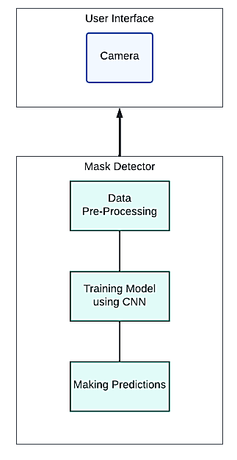
Block Diagram

Slide 10
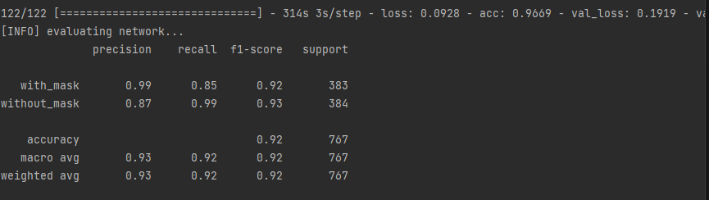
Results

